Slide 1
The top 10 things I bet you don't know about OUR library
Presented by the Shasta Library Foundation

Slide 2
1.
The library is innovative

Slide 3
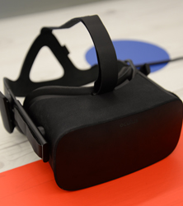
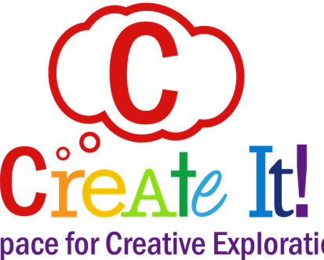
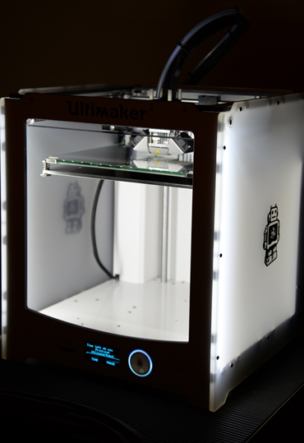
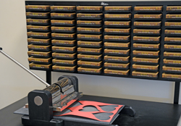
CreateIt Space
Notes:
CreatIT Space
3D printers
VR Oculus Rift, Vive
Die cutter
Sewing machine
Knitting and crochet supplies
Z space

Slide 4
2.
The library is a community hub

Slide 5
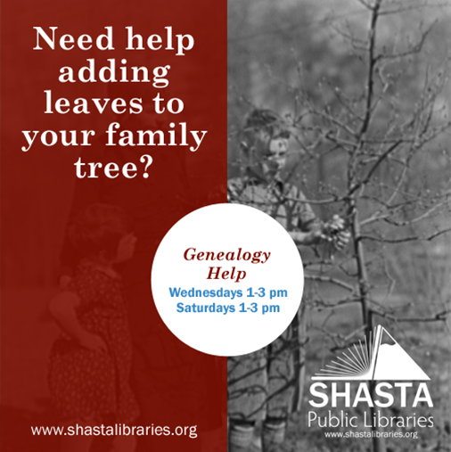
Library programs and events
Notes:
Community Connects
Summer Reading program for children and adults
Arthouse movies
Game night
Many more!

Slide 6
3.
The library helps bridge the technology gap

Slide 7
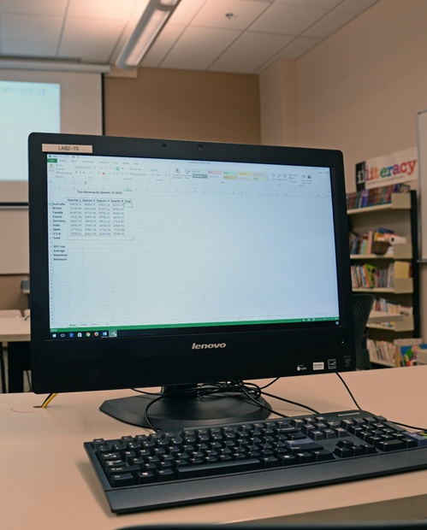
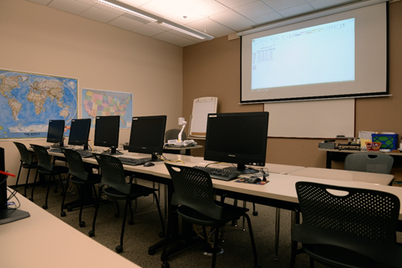
Computer classes and librarian help
Notes:
Regular computer classes.
Excel, word, iphone, tablet and others

Slide 8
4.
The library helps adults learn to read and get jobs

Slide 9
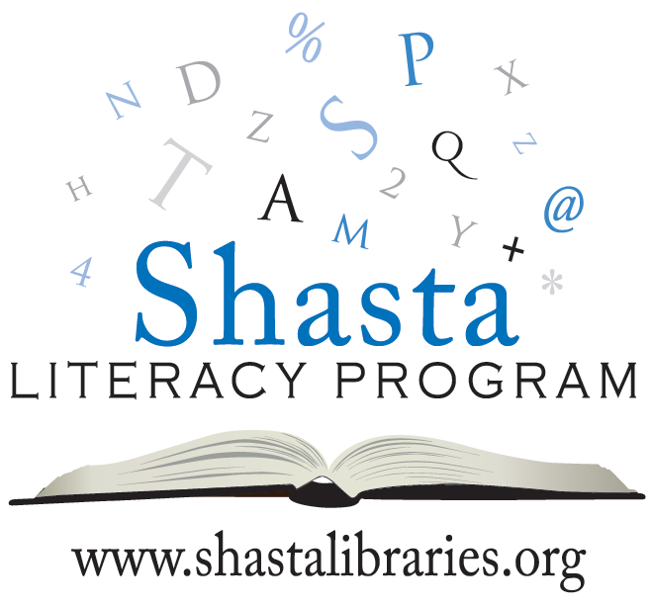
Adult Literacy Center, GED & Citizen classes

Slide 10
5.
The library improves the lives of Veterans

Slide 11
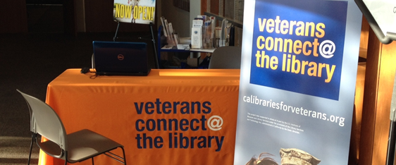
Veterans Resource Center Tuesdays 10-12pm

Slide 12
6.
The library invests in our community's kids and families

Slide 13
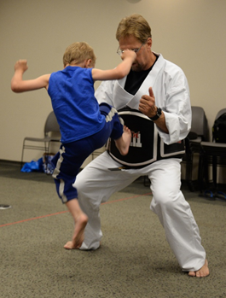
Storytime & children's events

Slide 14
7.
The library is a leader in California with their Student Success Initiative

Slide 15
Cards for all students & HelpNow!

Slide 16
8.
The library empowers teens to be leaders in the community

Slide 17
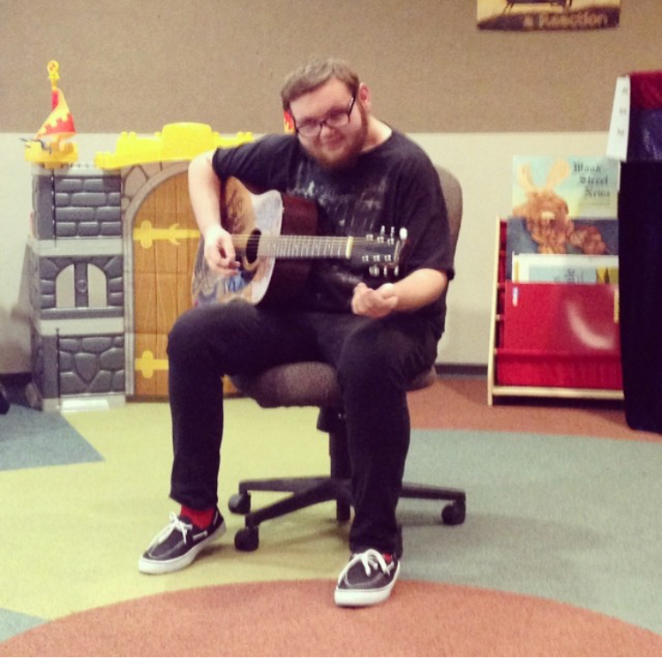
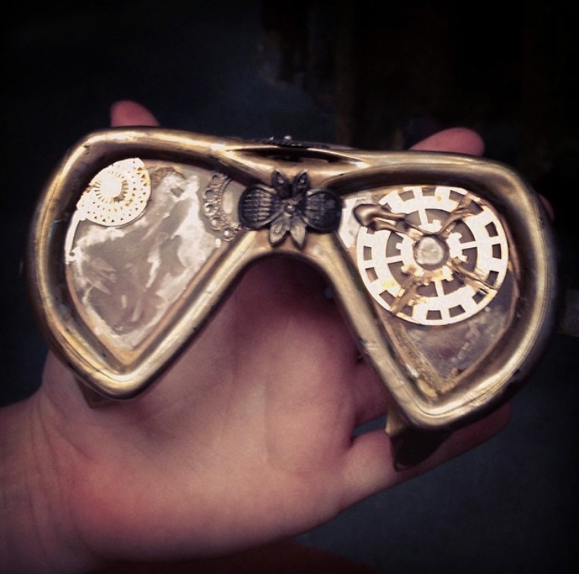
Teen Advisory Board

Slide 18
9.
You don't have to visit the library in person to use it!

Slide 19
E-resources:
Notes:
Databases- Consumer reports, Auto manuals, test prep (dmv, ASVAB, certificate, CBEST)
Ebooks- Overdrive has over 8500, Enki 55000
Audio books
Magazines- Rbdigital

Slide 20
10.
YOU can help the library today

Slide 21
Ways to support the library:
Become a monthly donor
Donate on Giving Tuesday
Partner with us
https://www.shastalibraryfoundation.org/
Notes:
The Shasta Library Foundation’s immediate goal is to develop a $4 million endowment to provide at least $200,000 each year to maintain and grow the library collection. Since the formation of the Shasta Library Foundation in 1991, our assets have grown from $350 to $1.5 million and we have contributed almost $600,000 to enrich our public libraries' resources and services. We believe it will take the efforts of the public and private sectors working together to provide the library resources and services our community wants and needs.

